Slide 1
Delivering the Future

Slide 2

Our guiding principles
Purpose of “Delivering the Future”…….
  To provide a more effective police force
  To meet our future funding requirements
  Preventing crime in partnership comes first
  Quality of service to the public is paramount
  We will take the best bits of what we do and
  further improve our service to you
  Our future delivery model has been developed by our people, with the public’s needs at the centre of everything we do
  We will remain embedded in communities and offer a local policing service that means we will be there when you need us

Slide 3
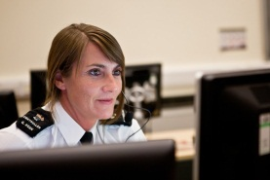


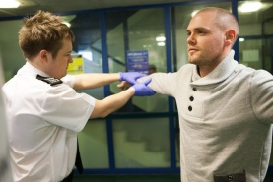


Delivering the future of your local policing service
“We all have a role to play to prevent,
intervene early, and halt the
deterioration of problems in our
local communities.”
Chief Constable Chris Eyre
IMPROVING SERVICE WITH OUR PARTNERS
“First point of contact”
Callers will receive a quicker and more efficient service. We will endeavour to resolve your call at the first point of contact.
The right person will be there when you need them, at a time and place convenient to you.
“Supporting
you through
investigations”
What matters to you as a victim of crime is how we treat you as an individual.
Keeping you updated on the progress of an investigation and supporting you throughout the inquiry and court process.
We are modernising the way in which we work.
We are investing in a mix of specialist staff and officers in investigation teams such as statement takers, civilian investigators, case builders, telephone liaison officers and office support.
“If.. ..I’m a member of the public”
“If.. ..I’m a victim”
“If.. ..I’m vulnerable”
“If.. ..I’m an offender”
We work with partner agencies to provide care and support to keep you safe and prevent you from becoming a victim of crime, and get you specialist support
Giving you confidence that we will
be there when you need us 24/7 by;
Dedicated officer assigned to your
case to provide
ongoing care
and support.
Specialist support
available for you.
- Phone
- Website
- Police station
Shared service
counter
Visible patrols
Local events
Prisoner handling teams to deal with your case from start to finish. Effective custody suites with state-of-the-art technology.

Slide 4
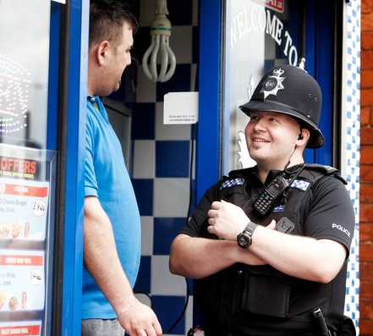
Prevention in action
Improving Service with partners
“We all have a role to play to prevent, intervene early,
and halt the deterioration of problems in our
local communities.”
Chief Constable Chris Eyre
Education in schools on bullying, drug and alcohol abuse, dangers of knives, sign of abuse and violence, road safety.
‘In Our Hands’ project in Manton, Worksop is a multi-agency programme led by the Holocaust Centre in schools to raise aspirations among pupils and parents.
Training front line workers to intervene early.
Training Co-ordinator employed to train front line workers i.e. postal workers, bin men, security guards, community nurses to spot signs of potential crime or vulnerability.
Enlist the help and support of people across Notts that have direct face-to-face contact with the
public.
More than 200 Prevent Ambassadors will be appointed in organisations such as councils, health service, sports centres, children’s centres, youth clubs.
Maximise opportunities and investment that businesses can bring to preventing crime.
Recruit more businesses to the Retail Crime Initiative which through business investment funds diversionary activities for vulnerable young people.
Share knowledge, data and best practice with our partners to solve problems quickly
Give front line workers immediate access to police and health data where mental illness could be a key factor in someone’s safety.
Work more closely with building planners to ‘design out’ crime in housing estates and shopping
precincts.
Working with building companies to ensure high standards of windows, doors and locks on new builds.
Increasing use of CCTV in public areas.

Slide 5

First point of contact
Staff fully trained in the use of the
National Decision Making Model to effectively resolve calls swiftly
Contact Resolution Incident Management (CRIM) is a
new way of working in the control room.
Response teams focusing on responding to emergencies and high priority calls
More than 30% of all crime will be dealt with by trained investigators over the telephone.
Reduce demand on front line officers and staff
by resolving calls at first point of contact
Telephone Investigators can call upon other resources to assist with investigations
Based on the experience of other forces;
80,000 callers will receive a swifter and more effective service.
Working with key
partners to establish
a “Multi Agency Hub”

Slide 6

Investigations
What matters to a victim of crime is how we treat them as an individual, keep them updated on the progress of an investigation and support them throughout the inquiry and court process.
We are modernising the way in which we work.
We will have a mix of specialist staff and officers in investigation teams such as statement takers, civilian investigators, case builders, telephone
liaison officers and office support.
These roles will conduct the investigations allowing more officers to be in the community following active lines of enquiry.

Slide 7
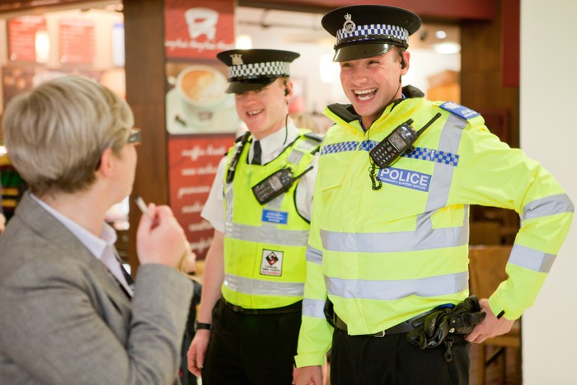
Delivering the future of your local policing
Visible policing in a one team approach with partners i.e. environmental health, licensing, DVLA, housing, Trading Standards
Advice and support 24 hours a day by website, e-portal, phone, email, local officer, social media
You will see and hear about prevention work in partnership
You will see more volunteers working with the police in your local area and have the opportunity to get involved yourself
Your area will have a named officer
Reassurance that highly skilled officers and specialist teams are dealing with serious crime to keep you safe
You can visit a police station front counter, a Shared Service front counter or use e-portal

Slide 8

If I’m a victim
Officers ready to respond when you need them either in person or over the phone
In an emergency, an immediate response by specialist officers including response, firearms, public order, violence teams, mental health triage
Non-emergency, a scheduled appointment at a time to suit you at your home or at a station
Your call could be dealt with over the telephone by a trained investigator if it is appropriate
Your call may be better dealt with by one of our partner agencies

Slide 9

Support for victims
For serious, complex offences we have specialist teams working county-wide i.e. domestic violence safety planners, Independent Domestic Violence Advisors, family liaison officers
Dedicated point of contact throughout your case
Support and witness care throughout for you and your family
Under the Victims’ Code enhanced support for vulnerable victims including children, victims of sexual offences, serious crime and persistent and targeted victims
Support throughout the entire court process provided by our officers and staff, Victim Support and other charities

Slide 10
If I’m vulnerable
People may be vulnerable through age (children
and the elderly) drug and alcohol abuse,
disability, physical and mental illness, repeat
victim, through difference i.e. hate crime
We will work together with partners to safeguard
vulnerable people to reduce their chances of
becoming a victim of crime.
Mental Health Triage Cars
The street triage pilot scheme has already ensured that vulnerable people receive the right care by mental health specialists, avoiding unnecessary detention and associated anxiety.
This is being done by triage nurses and police officers conducting an immediate joint assessment so that decisive action can be taken.

Slide 11

If I’m an offender
Speeding up the process…….
Officers with the IT capability to share information directly with custody suites i.e. witness statements for handover packages
Prisoner handling teams will deal with prisoners from start to finish, freeing up response officers
Custody staff available at high peaks of demand to deal with prisoner processing
Officers will use restorative justice in the community where appropriate
PCSOs and CPOs may give warnings and on-the spot fines
Where appropriate, you can volunteer to attend a station and meet an officer
Preventative partnership schemes to stop re-offending i.e. alcohol and drug diversion scheme, driving courses

Slide 12

If I’m a partner
Support the creation of a multi-agency hub within the force control room to help resolve customer issues quicker at first point of contact
Encourage and promote ways in which the public can become involved in policing and preventing crime
Help us to enlist the support of 200 Prevent Ambassadors within organisations to help prevent crime and spot early warning signs of vulnerability
Support multi-agency initiatives such as ‘In Our Hands’, ‘Priority Plus Areas’ and the ‘Retail Crime Initiative’
Support and provide preventative partnership schemes to stop re-offending i.e. alcohol and drug diversion scheme, driving courses
Have partnership staff integrated in local policing teams to strengthen partnership working
Improve the sharing of data to protect and safeguard vulnerable people

Slide 13
Delivering an excellent public service and the financial implications….
Over the next comprehensive spending review (CSR) period (2014-2020) we expect a funding shortfall of over £30m (16% reduction in funding)…
…….by delivering the new policing model and effective financial management, we will deliver a balanced budget over this period (2014-2020)
£211.7m
£193.8m
(£17.9m)
£30.4m
Expected
Cost Increase
£181.3m
Funding Gap
addressed by
the new
operating model
Today it costs
£193.8m to
deliver a service
If everything stays the same,
and adding inflation, the cost to
provide the same service would
be £211.7m by 2020
However we anticipate funding
over the same time period to
reduce to £181.3m,
Therefore leaving a £30.4m gap.
The new policing model will deliver
an improved quality of service as
well as addressing the funding gap

Slide 14
……By delivering the new policing model and effective financial management,
we will deliver a balanced budget over this period (2014-2020)
Over the next
comprehensive
spending review
Period (2014-20)
we expect
underlying funding
to reduce.
£193.8m
£181.3m
In the short term,
to deliver the
new policing
model will utilise
£12.0m of MTFP
Reserves

Slide 15
To deliver the new local policing service, will require
a different shape workforce……
We will change the workforce mix to meet our new requirements,
We plan to continue to recruit police officers over the next 5 years
We will employ fewer people – exact numbers will depend on the
outcome of the General Election and the 2015 CSR settlement
We will redeploy officers and police staff to deliver the new policing service
The percentage of our staff in operational roles will increase.

Slide 16
Any Questions

