Slide 1


Single Online Home,
Nottinghamshire Police
Local identity, national consistency

Slide 2

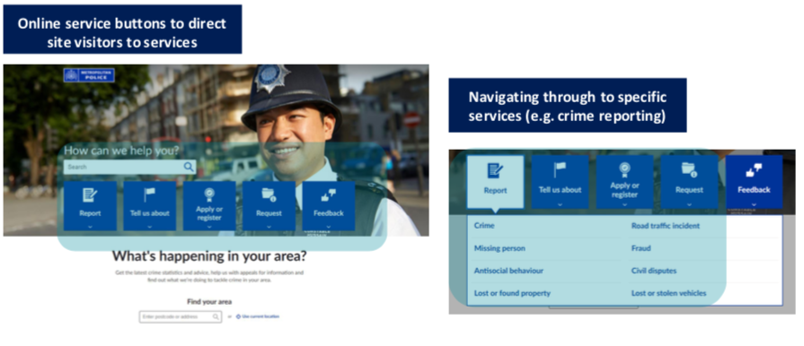
What is SOH?
All forces who subscribe to SOH get the benefits of a standardised and consistent user experience, currently live across 30 live forces, in a highly safe and secure environment for citizens. Services are developed after nationwide, robust consultation with forces.
Effective Triage
Dynamic forms
Meaningful outcomes
Using
Leading to
Asking the right customer focused questions to understand what is right for them and for us.
Dynamically building the questions we need to ask based on the triage to ensure forms automatically are sent to the right business area with the right information.
Providing users with appropriate reference information and collecting evidence in an appropriate format to investigate and prosecute if necessary.

Slide 3
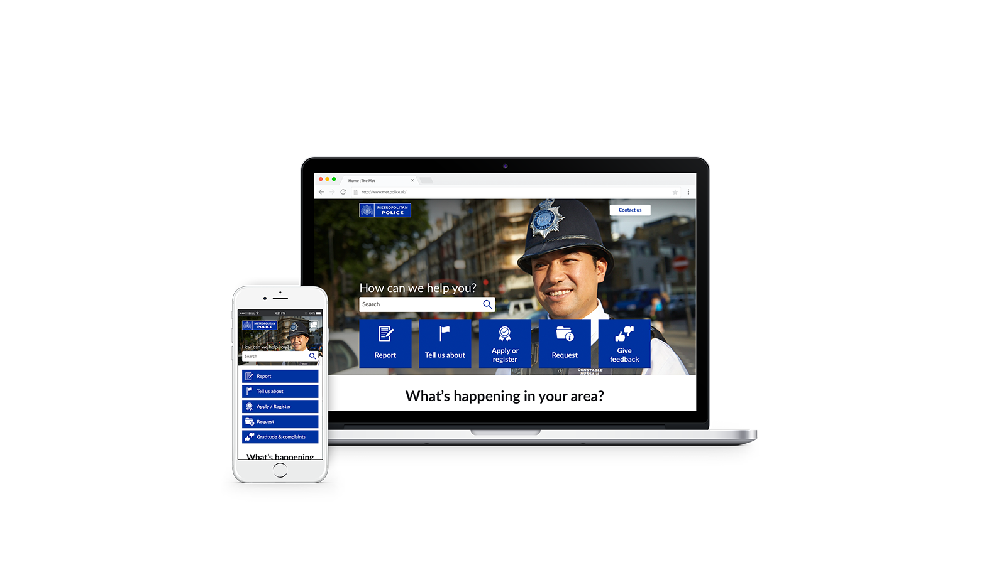
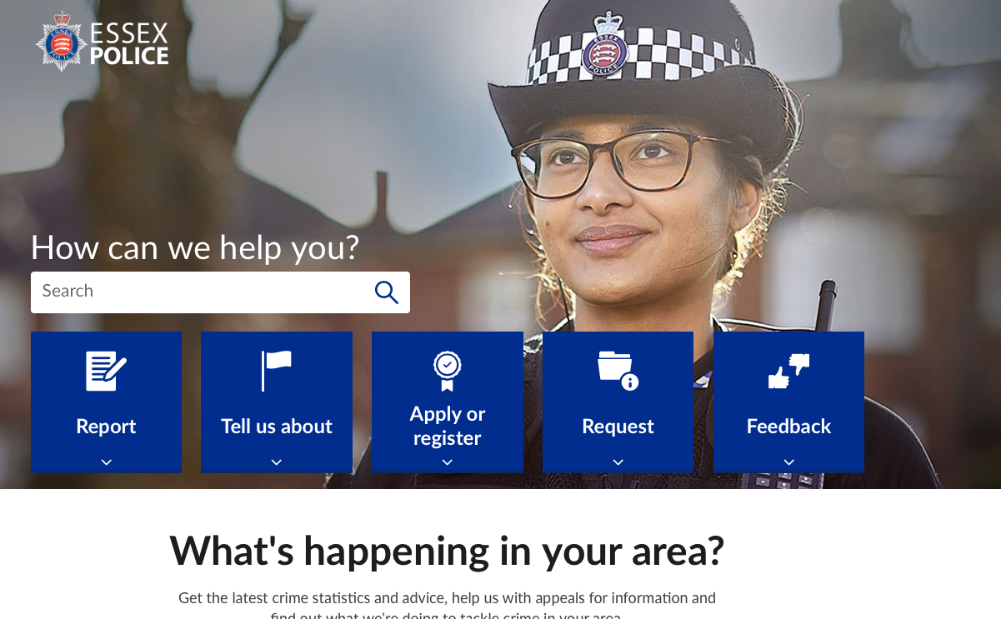
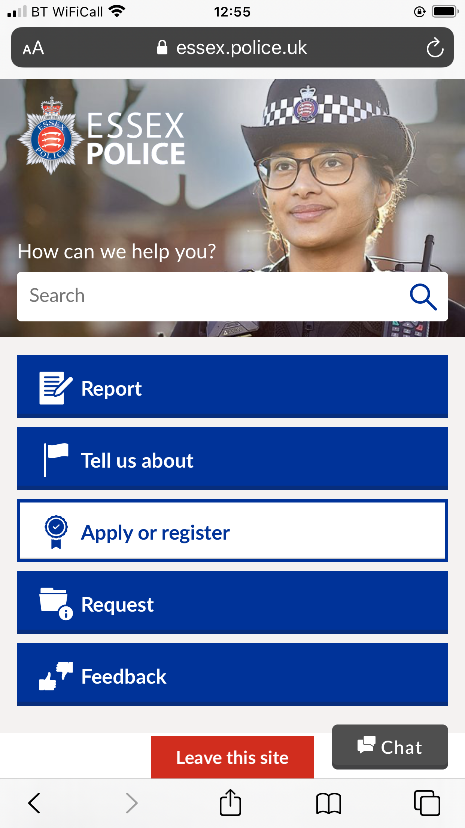




This is more than just a website...
Single Online Home (SOH) provides a national web-based platform and aspires to be a digital front counter for the public, offering a broad range of online police service.
On SOH people can access information, advice and services when and wherever they are for reporting a crime, applying for a licence and local crime information. It enables the public to do everything they can do through 101 online.
    Educates the public about what services the police offer, via their channel of choice and signposts to third party services when more appropriate - reducing calls to 999/ 101
    Empowers the public to be self-sufficient and take control when dealing with the police
    Is future proofed, secure and scalable with a site architecture that supports people to find the information and services they need fast
    Gives the public new ways to contact the police, such as Social Media, that are more relevant, convenient, richer and easier to manage for the police

Slide 4
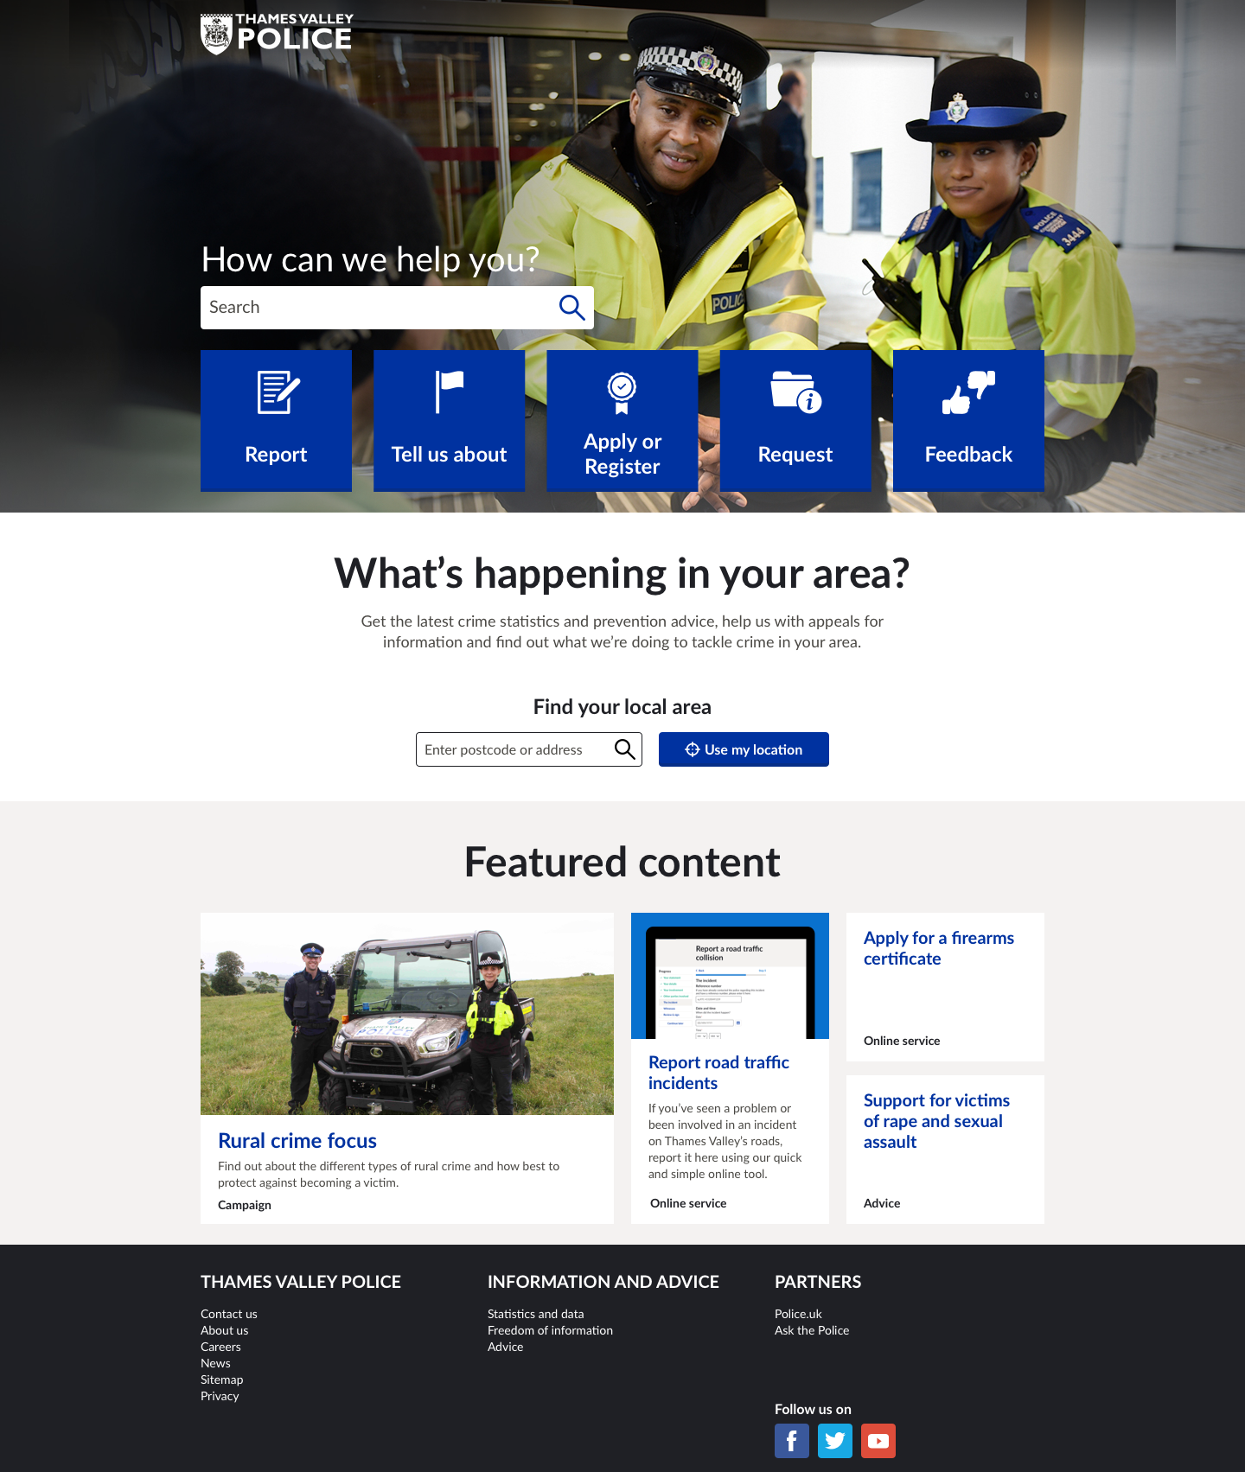
SOH-Full: Local identity, national consistency
Local services & content
[Supplied by each force, ADR & Police UK]
National services & content
[Managed centrally]
National Steering Group
Working with all SOH Forces to develop Services
Local identity
Logo, homepage image, etc
National services
Crime reporting, RTI, etc
Careers
Advice and information
eg How to apply, Crime prevention etc.
My local area
Local news and campaigns
National news and campaigns
About us
National stats and publications

Slide 5
Why SOH – benefits to Public and Police
DPC Impact Team analysis showed that SOH has a positive impact for both the public and police forces.
A study completed in July 2020 showed a range of benefits for public and police forces alike. For example, the public have improved access to the police via a platform which directed them to the right resource or form. Meanwhile, forces can benefit from a channel shift and SOH assisting in managing incoming contacts and demand.
For the Public
For the Force
Helping communities make informed decisions
Prevention, Effectiveness, Efficiency, Legitimacy
Locally-relevant stats and data
Crime-prevention, advice and information
Future digital front counter
Self Service
Social media
Campaigns & news
Nationally consistent processes and systems
Prioritising critical incident response
Community survey
More choice
Reduced calls and fewer station visits
Reduction in duplication and effort
Giving feedback on the service they’ve received
Freedom of Information database
Better information in
Data ready to pass on and output is evidence
The SOH Services and our force delivery models are constantly being improved and evolved to best meet the needs of forces and the public.

Slide 6








Services Overview
SOH includes a comprehensive and expanding portfolio of services, developed in consultation with National Police forces
Covid-19 reporting and Domestic Abuse were as a result of emergence of national public safety requirements.
Membership of the National Steering Group enables all Forces to participate in the evolution of the platform
All services are subject to continuous improvement in line with force requirements and governmental or legislative changes to further develop the service e.g. RTI, FAL, ASB and OCR, all of which have new versions in the pipeline
Report
Tell us
about
Apply & Register
Request
Feedback
Other Services
Covid Reporting
Fraud
Possible terrorist activity
FAL
Careers
Collision Report
Clare’s Law
About the website
Contact Us
Home page & news
ASB
Reporting
Civil Disputes
Events & Processions
Attend a misconduct hearing
Watch Schemes
Intellectual Property License
Counter-Terrorism advice
Thanks & Complaints
Live Chat
About us / force info
Services on the platform
PREVENT Referral
Overseas visitors
Information about the Force
FOI
Your area
General advice & info
On-line Crime Reporting
Lost & Found property
RTI
Reporting
Lost or stolen vehicle
Notify to Film
Your Fingerprints
= Interactive service
Rape & sexual assault
Domestic Abuse Reporting
Sarah’s Law
Live Chat Strategic solution
= Links to a 3rd party site
Services Development
= Initial triage and / or poss. re-direct to 3rd party site
Missing Persons
Bribery & corruption
= Info only service

Slide 7

Questions

